Slide 1

INSTITUTE - UIE
DEPARTMENT- ACADEMIC UNITS
Bachelor of Engineering (Computer Science & Engineering)
Subject Name: Elementary Data Structure Using C++
Code:23CSH-103
Introduction
DISCOVER . LEARN . EMPOWER

Slide 2


Elementary Data Structure Using C++
Course Objectives
To enable the students to understand various stages and constructs of C++ programming language.
To improve their ability to analyze and address variety of problems in C++.
To understand the concept of data structures and various operations on them.
To understand the properties of various data structures and able to identify the strengths and weaknesses of different data structures.
To analyze and compare the efficiency of algorithms and learn to design efficient algorithms for solving computing problems

Slide 3



Course Outcomes
CO Number | Course Outcome
CO1 | Understand the concepts of object-oriented programming including programming process and compilation process.
CO2 | Apply different techniques to decompose a problem and programmed a solution with various concepts of object-oriented programming language.
CO3 | Analyse and explain the behaviour of linear data structure operations using the programming addressed in the course.
CO4 | Implement and evaluate the programs using the syntax and semantics of object-oriented programming.
CO5 | Design the solution of real-world problems in order to determine that the program performs as expected.

Slide 4

Scheme of Evaluation

Slide 5
CONTENTS
Concept of Data and Information
Introduction to Data Structures
Notes:
Computer in the diagram is 3rd generation computer. The period of third generation was from 1965-1971. The computers of third generation used Integrated Circuits (ICs) in place of transistors. A single IC has many transistors, resistors, and capacitors along with the associated circuitry. The main features of third generation are −
IC used
More reliable in comparison to previous two generations
Smaller size
Generated less heat
Faster
Lesser maintenance
Costly
AC required
Consumed lesser electricity
Supported high-level language

Slide 6
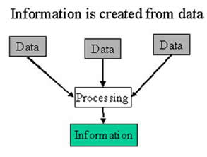
Data & Information
Data and information are interrelated. Data usually refers to raw data or unprocessed data.
Once the data is analyzed, it is considered as information.
Data - Data usually refers to raw data, or unprocessed data. It is the basic form of data, data that hasn’t been analysed or processed in any manner.
Information - Once the data is analysed, it is considered as information.
http://www.differencebetween.info/difference-between-data-and-information

Slide 7
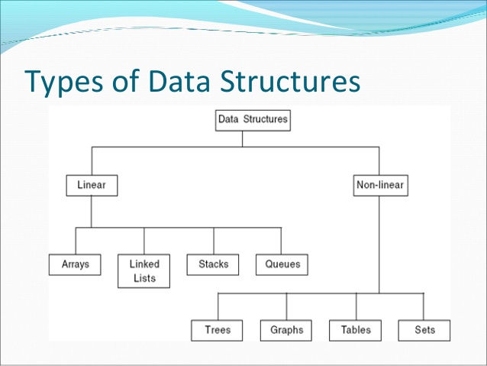
Data Type & Data Structure
Data type
Set of possible values for variables
Operations on those values
Ex : int, float, char ……….
Data Structure
A data structure is an arrangement of data in a computer's memory or even disk storage.
The logical and mathematical model of a particular organization of data is called a data structure.
A data structure is a particular way of storing and organizing data in a computer so that it can be used efficiently.
https://www.kullabs.com/classes/subjects/units/lessons/notes/note-detail/4094

Slide 8
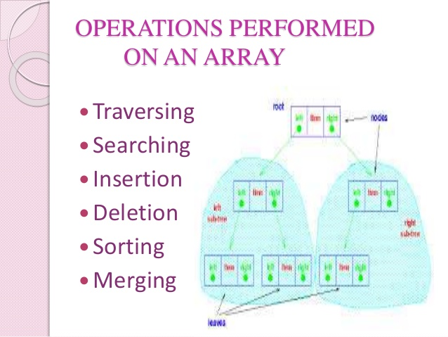
Operations on Data Structure
Traversing: Accessing each records exactly once so that certain items in the record may be processed.
Searching: Finding the location of a particular record with a given key value, or finding the location of all records which satisfy one or more conditions.
Inserting: Adding a new record to the structure.
Deleting: Removing the record from the structure.
Sorting: Managing the data or record in some logical order(Ascending or descending order).
Merging: Combining the record in two different sorted files into a single sorted file.
https://www.slideshare.net/rameeshasadaqat/data-structure-its-types/

Slide 9
Algorithm Complexity
Algorithm complexity is a measure which evaluates the order of the count of operations, performed by a given or algorithm as a function of the size of the input data.
To put this simpler, complexity is a rough approximation of the number of steps necessary to execute an algorithm.
When we evaluate complexity we speak of order of operation count, not of their exact count.
For example if we have an order of N2 operations to process N elements, then N2/2 and 3*N2 are of one and the same quadratic order.
Algorithm complexity is commonly represented with the O(f) notation, also known as asymptotic notation or “Big O notation”, where f is the function of the size of the input data.
The asymptotic computational complexity O(f) measures the order of the consumed resources (CPU time, memory, etc.) by certain algorithm expressed as function of the input data size.

Slide 10
Algorithm Complexity
1. Space Complexity - The space complexity of an algorithm ,hence program ,is the amount of memory it needs to run to completion. Some of the reasons for studying space complexity are:
If the program is to run on multi-user system, it may be required to specify the amount of memory to be allocated to the program.
We may be interested to know in advance that whether sufficient memory is available to run the program.
can be used to estimate the size of the largest problem that a program can solve.
2. Time Complexity – The time complexity of an algorithm is the amount of time it needs to run to completion. Some of the reasons for studying time complexity are:
We may be interested to know in advance that whether the program will provide a satisfactory real-time response. For ex, an interactive program such as editor, must provide such response. If it takes even a few seconds to move cursor one page up or down, it will not be acceptable to the user.

Slide 11
Algorithm Complexity
Time-space tradeoff– The best algorithm , hence best program , to solve a given problem is one that requires less space in memory and takes less time to complete its execution. But in practice, it is not always possible to achieve both of these objectives.
Best case Complexity – The term best-case performance is used in computer science to describe an algorithm's behaviour under optimal conditions. For example, the best case for a simple linear search on a list occurs when the desired element is the first element of the list.
Average Case Complexity– The average-case complexity of an algorithm is the amount of some computational resource used by the algorithm, averaged over all possible inputs
Worst Case Complexity– The worst-case measures the resources (e.g. running time, memory) an algorithm requires in the worst-case. It gives an upper bound on the resources required by the algorithm.

Slide 12
Various complexities of algorithms
Constant: O(1)→ constant number of operations, not depending on the input data size,
e.g. n=10000→ 1 operation.
Logarithmic: O(log n)→ No. of operations proportional of log n where n is the size of input data,
e.g. n=1000→10operations.
Linear: O(n)→no. of operations proportional to the input data size,
e.g. n=10000→ 10000operations.
Quadratic: O(n²)→No. of operations proportional to the square of the size of the input data.
e.g. n=500→250000 operations
Cubic: O(n³)→ no. of operations proportional to the cube of the size of the input data,
e.g. n=10→ 1000 operations
Exponential: exponential no. of operations, fast growing,
e.g. n=20→ 1048576 operations.

Slide 13
Applications
To improve the agility of software.
To decrease maintenance cost.
To meet architectural standards and improve code quality.

Slide 14
REFERENCES
Lipschutz, Seymour, “Data Structures”, Schaum's Outline Series, Tata McGraw Hill.
Goodrich, Michael T., Tamassia, Roberto, and Mount, David M., “Data Structures and Algorithms in C++”, Wiley Student Edition.
https://www.tutorialspoint.com/data_structures_algorithms/algorithms_basics.htm
https://www.cs.utexas.edu/users/djimenez/utsa/cs1723/lecture2.html
Lipschutz, Seymour, “Data Structures”, Schaum's Outline Series, Tata McGraw Hill.
Lipschutz, Seymour, “Data Structures”, Schaum's Outline Series, Tata McGraw Hill.
Gilberg/Forouzan,” Data Structure with C ,Cengage Learning.
Augenstein,Moshe J , Tanenbaum, Aaron M, “Data Structures using C and C++”, Prentice Hall of India

Slide 15
THANK YOU

